Slide 1
Creating Compelling Video Content with your Smart Phone
Rachel Horst, Brevard Public Schools

Slide 2
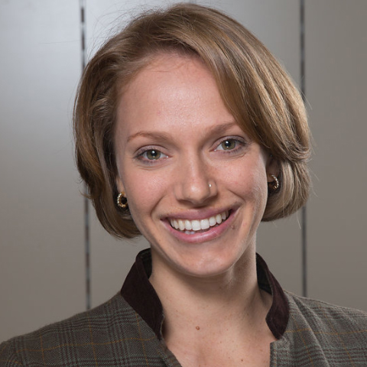
Background
Bachelor of Science in Telecommunication from the University of Florida
Tight Line Productions/Digital Zoetrope Productions
A Cut Above Video Productions
Brevard Public Schools, Digital Communication Specialist

Slide 3
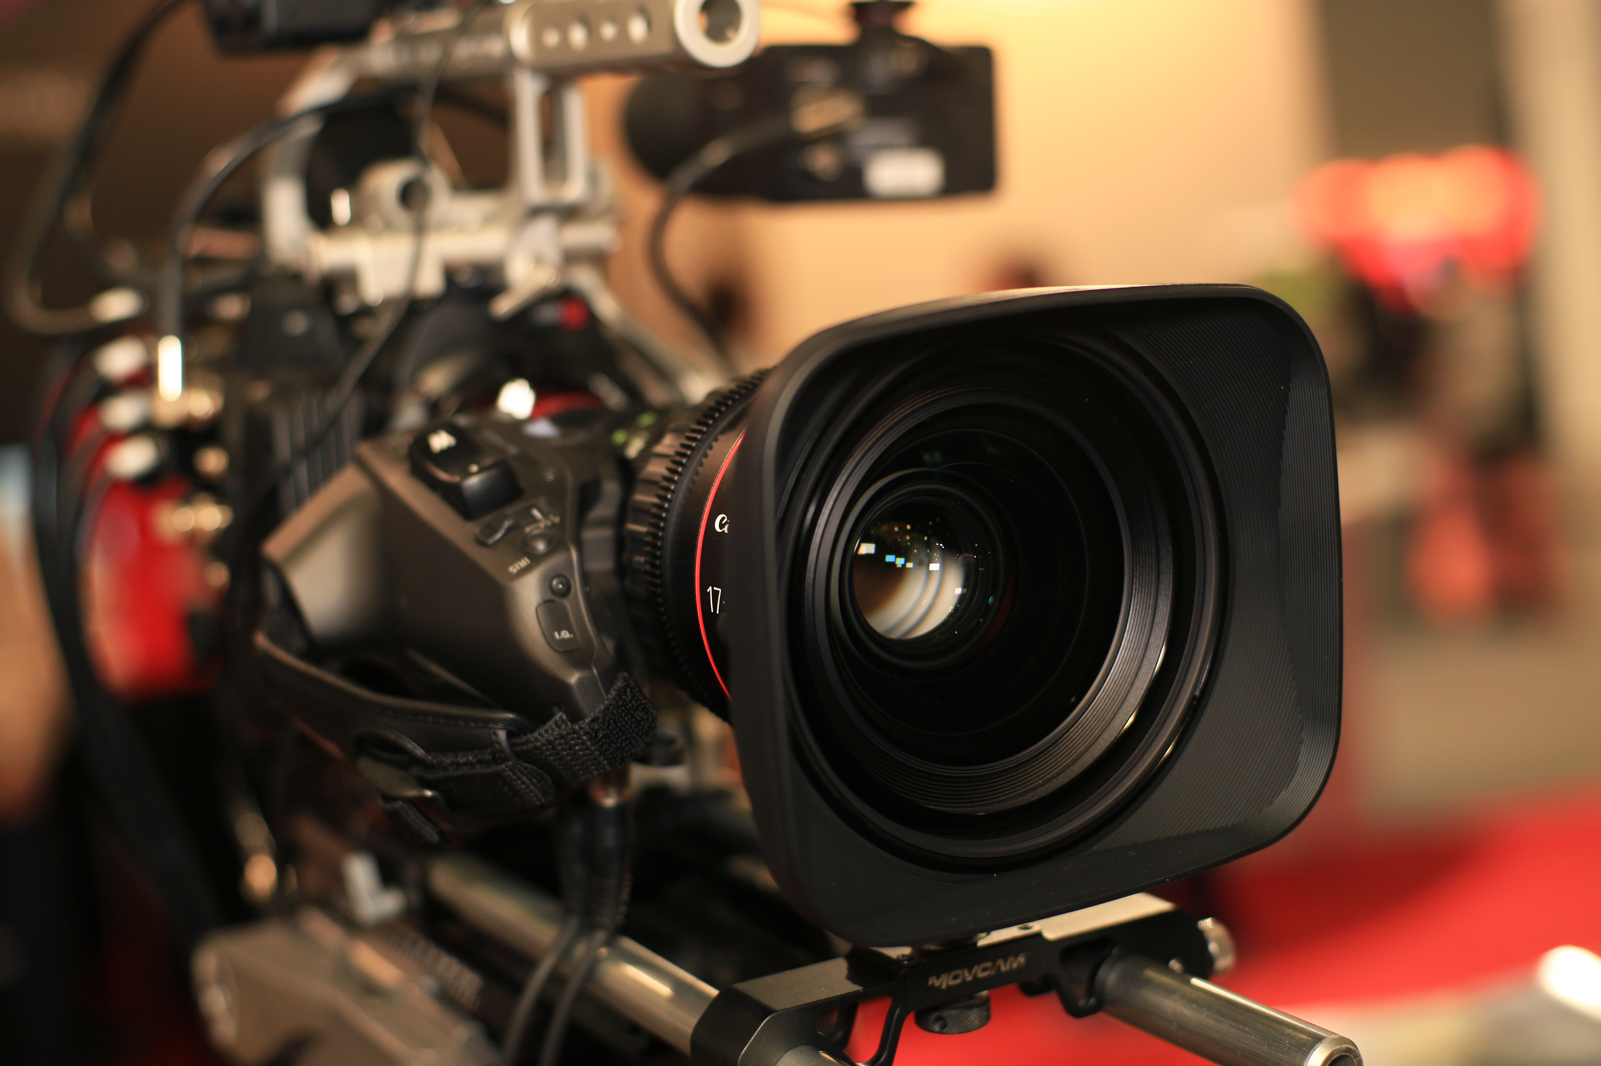
Smart phones vs. professional video services
Pros
Quick
Easy
Fast
Good quality
Cons
Often shaky
Limited capability
Pros
Experience
Expertise
Excellent quality
Cons
Cost
Timeline
Notes:
How many of you have smart phones?

Slide 4
Prepare
Always test your devices
Don’t use phone zoom, move your feet
For Facebook Live or similar:
If possible, put your phone on airplane mode and use wifi
Test wifi connection with speedtest, upload speed >2-4 mbps
Shoot horizontally not vertically

Slide 5
Types of Video
Storytelling
Live coverage
Framing
Composition
Script/storyboard
Test your equipment
Under promise and over deliver
Check your frame

Slide 6
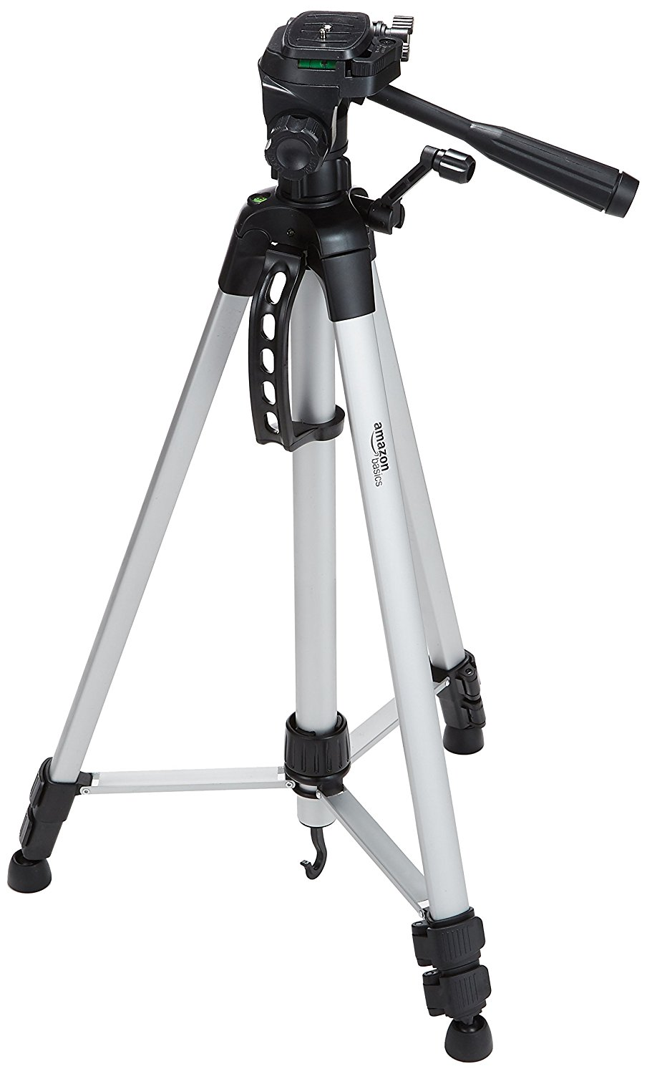
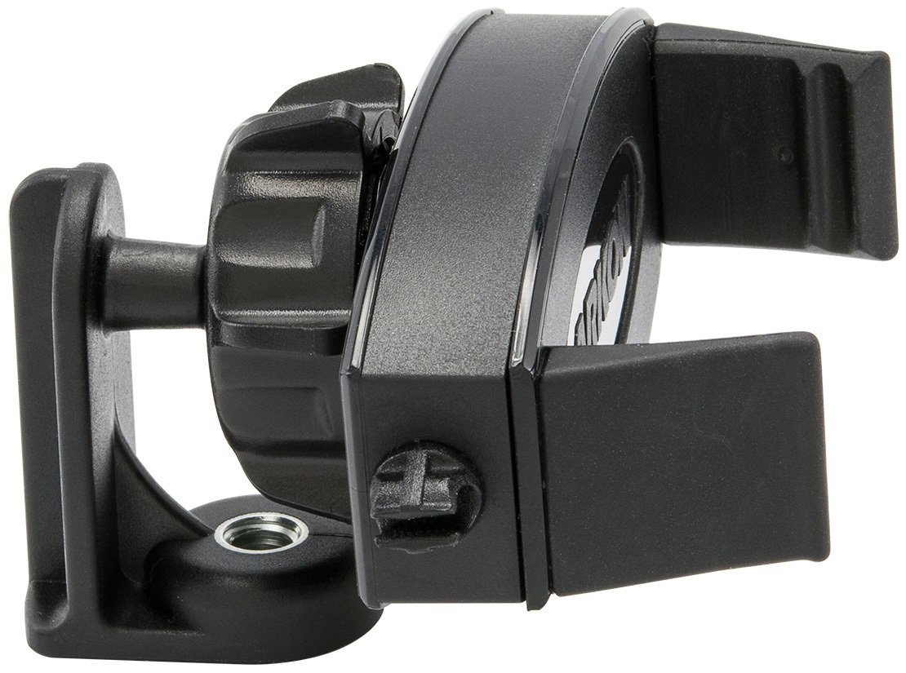
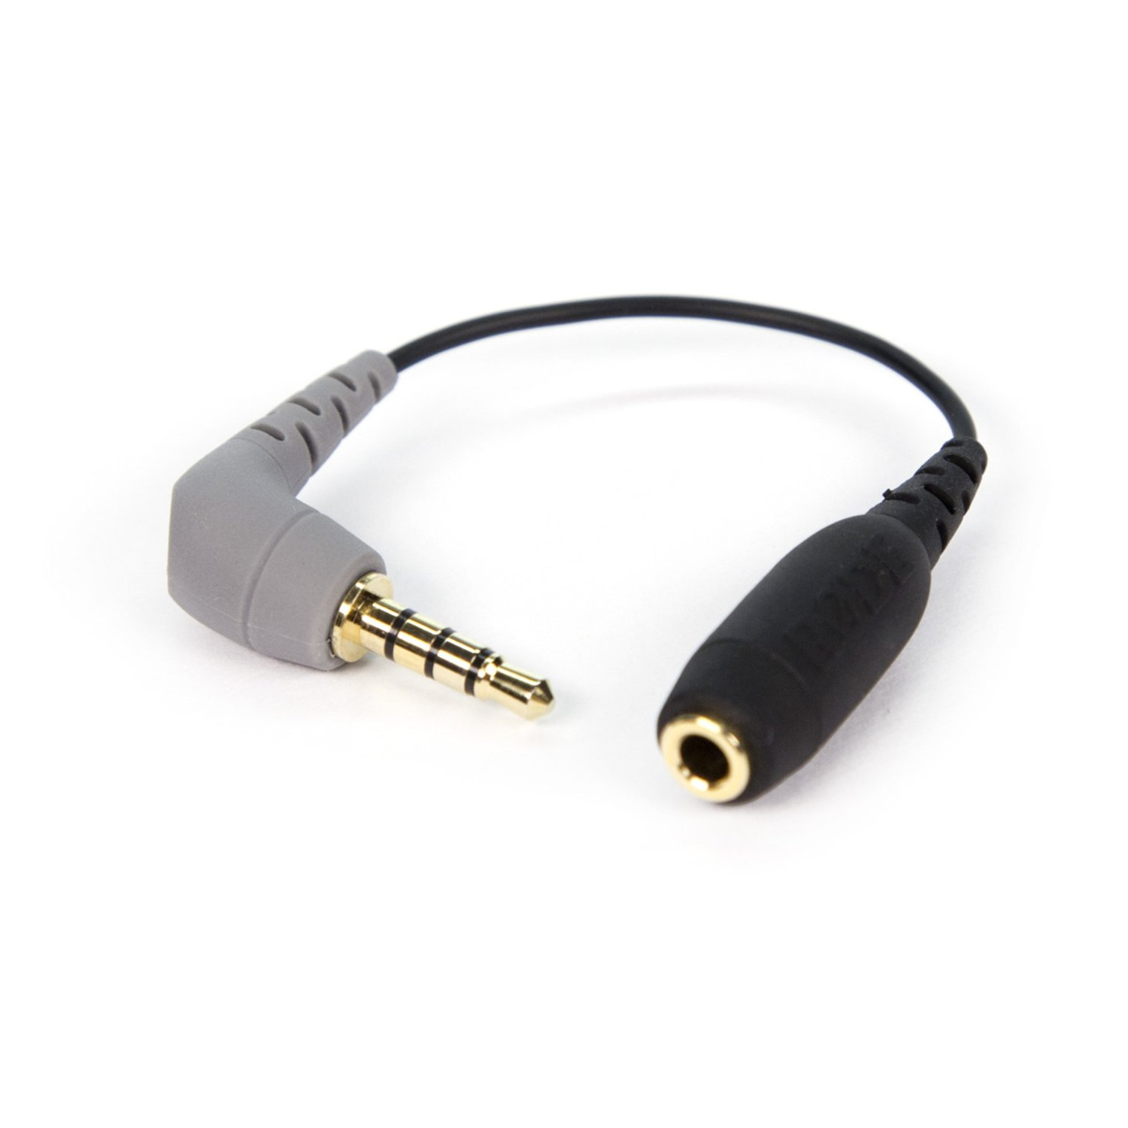
Equipment
Tripod: $24
Tripod mount: $13
Audio cord: $15

Slide 7
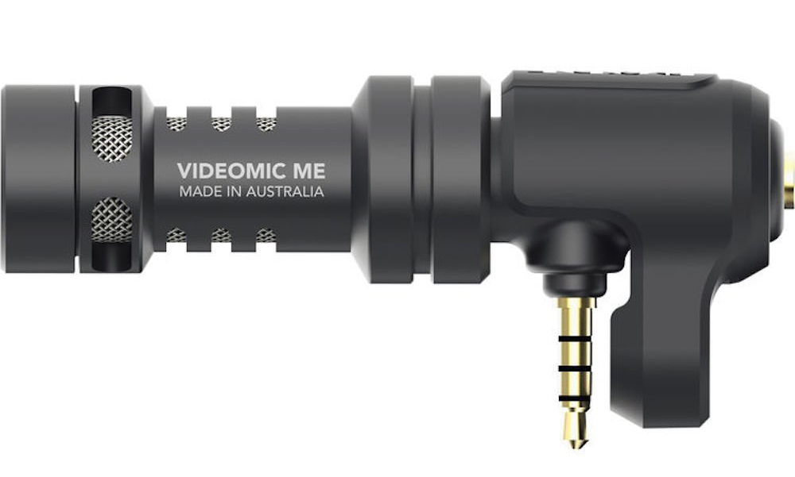
Audio
Lavalier
Shotgun
Good for one person
Ideal for presentations
Isolates audio in a loud setting
Example: $36
Good for multiple people
Provides more natural sound
Hard to isolate speaker’s audio
Example: $59

Slide 8
Dr. Blackburn presentation – Facebook Live
Notes:
Family Resource Night,

Slide 9
Editing software
Splice:
iMovie:
Adobe Creative Suite: Premiere Pro

Slide 10
The Fountains

Slide 11
Tied Together

Slide 12
Questions
Horst.Rachel@brevardschools.org
321-633-1000 ext. 743

